Slide 1
Medical terminologies -8

Slide 2
Cardiology
Prefixes: cardio-, myo-, endo-
Roots: cardi (heart), ventriculi (ventricle), Atri (atrium)
Suffixes: -itis (inflammation), -megaly (enlargement), -Pathy (disease), -gram (record)

Slide 3
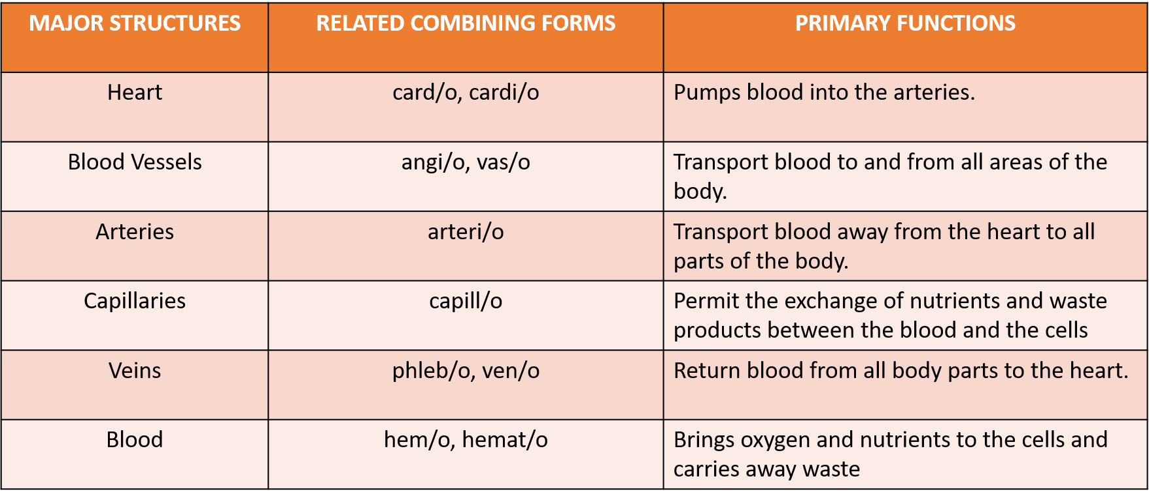

Slide 4
structures
The major structures of the cardiovascular system are the heart, blood vessels, and blood.
The Heart
The heart is a hollow, muscular organ located between the lungs.
It is a very effective pump that furnishes the power to maintain the blood flow needed throughout the entire

Slide 5
Pericardium
The pericardium also known as the pericardial sac, is the double-walled membranous sac that encloses the heart (peri- means surrounding,cardi means heart, and-um is a singular noun ending).
Membranous means pertaining to membrane, which is a thin layer of pliable tissue that covers or encloses a body part.
The parietal pericardium is the tough outer layer that forms a fibrous sac that surrounds and protects the heart.
The visceral pericardium, which is the inner layer of the pericardium, also forms the outer layer of the heart

Slide 6
Walls of heart
The walls of the heart are made up of three layers: the epicardium, myocardium, and endocardium
The epicardium is the external layer of the heart and the inner layer of the pericardium (epi- means upon, cardi means heart, and-um is a singular noun ending).
The myocardium also known as myocardial muscle, is the middle and thickest of the heart’s three layers and consists of specialized cardiac muscle tissue (my/o means muscle, cardi means heart, and-um is a singular noun ending). The constant contraction and relaxation of this muscle creates the pumping movement that maintains the flow of blood throughout the body.
The endocardium which consists of epithelial tissue, is the inner lining of the heart (endo- means within, cardi means heart). This surface comes into direct contact with the blood as it is being pumped through the heart.

Slide 7
Related terms
Atrium (Right/Left): Upper chambers receiving blood
Ventricle (Right/Left): Lower chambers pumping blood
Endocardium: Inner lining of the heart
Myocardium: Heart muscle layer
Epicardium: Outer heart layer
Pericardium: Protective sac around heart
Septum: Wall dividing right & left heart

Slide 8
Related terms
Aorta: Largest artery in the body
Pulmonary Artery: Carries blood to lungs
Pulmonary Veins: Carry blood from lungs to heart
Coronary Arteries: Supply heart muscle
Chordae Tendineae: Valve-supporting cords
Papillary Muscles: Anchor valves
SA Node: Natural pacemaker
AV Node: Electrical relay between atria & ventricles

Slide 9
Functional terms
Systole: Contraction phase
Diastole: Relaxation phase
Stroke Volume (SV): Blood pumped per beat
Cardiac Output (CO): SV × HR
Ejection Fraction (EF): % of blood ejected

Slide 10
Preload: Ventricular stretch before contraction
Afterload: Resistance against which heart pumps
Contractility: Strength of contraction
Heart Rate (HR): Beats per minute
Conduction System: SA → AV → Bundle of His → Purkinje fibers

Slide 11
Pathology
Arrhythmia: Irregular rhythm
Bradycardia: Slow heart rate
Tachycardia: Fast heart rate
Heart Failure: Poor pumping function
Endocarditis: Heart lining infection
Pericarditis: Pericardium inflammation
Myocarditis: Heart muscle inflammation

Slide 12
Pathology
Myocardial Infarction: Heart attack
Angina Pectoris: Chest pain
Cardiomyopathy: Heart muscle disease
Valvular Stenosis: Valve narrowing
Valvular Regurgitation: Valve leakage
Aneurysm: Vessel/heart wall bulge

Slide 13
Common prefixes and suffixes
Cardio-: heart (e.g., cardiology)
Myo-: muscle (e.g., myocardium)
Endo-: inside (e.g., endocardium)
Peri-: around (e.g., pericardium)
-itis: inflammation (e.g., pericarditis)
-megaly: enlargement (e.g., cardiomegaly)
-pathy: disease (e.g., cardiomyopathy)
-ectomy: removal (e.g., pericardiectomy)

